Slide 1
Cyclistic Customer Behavior Analysis Converting Casual Riders into Annual Members
Johnny Corona / July 10

Slide 2
Objetives
Business Objetives
Identify opportunities, based on data analysis, to develop marketing strategies that convert occasional users into annual member.
Business Problem
Identify the behavior and usage patterns of bicycles between casual riders and annual members to understand their differences. Based on these findings, design strategies to convert casual riders into annual members, increasing company profitability and fostering sustainable growth.

Slide 3
Data Description
Dataset Overview
12 months of historical data.
Over 5 million trips.
Variables analyzed:
User type Bike
Type Date and time
Trip duration Start and end stations
Trip by season

Slide 4
Exploratory analysis
During this project, we have based our analysis on the following KPIs
Ride Duration
Ride Frequency
Day of Week Month
Hour Bike Type Start Station

Slide 5
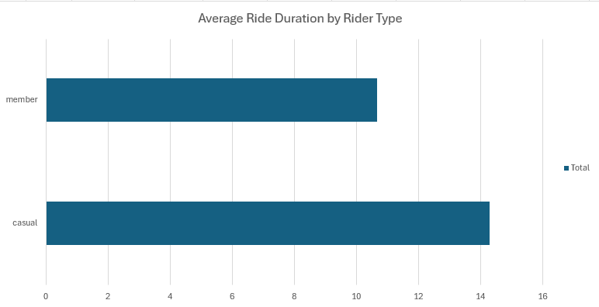
Average Ride Duration
Casual users take longer trips (14.3 min) than members (10.7 min), suggesting a more recreational use compared to the routine use of members and highlighting different needs between the two segments.
Recommendation:
Design memberships or promotional campaigns aimed at casual users with benefits for recreational and longer trips, encouraging their conversion to annual members.

Slide 6
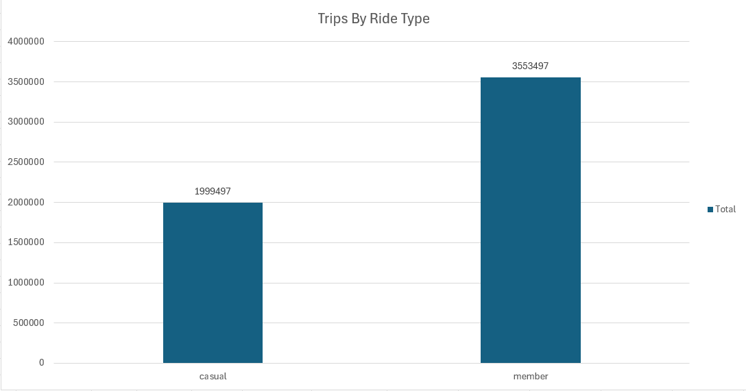
Trips by Ride type
Members generate substantially more trips than casual riders, accounting for approximately 64% of all rides, while casual riders represent around 36%.
Supporting data:
Members: 3,553,497 trips
Casual riders: 1,999,497 trips
Difference: 1,554,000 trips (members completed about 77.7% more trips than casual riders).

Slide 7
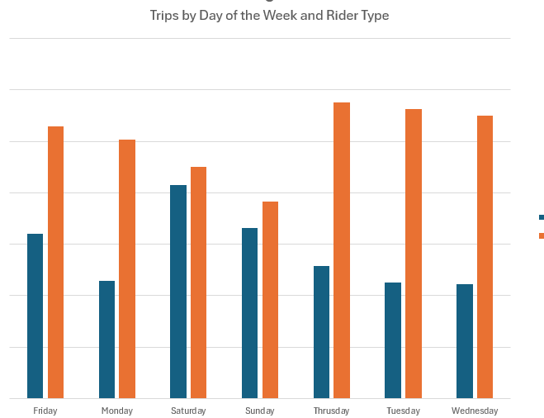
Trips by Day of the Week
Casual riders increase bike usage toward the weekend, peaking from Friday to Sunday, while annual members maintain consistent usage throughout the week, suggesting different travel behaviors and needs.
Recommendations
Launch weekend membership promotions targeting casual riders to increase annual membership conversions and improve customer retention.

Slide 8
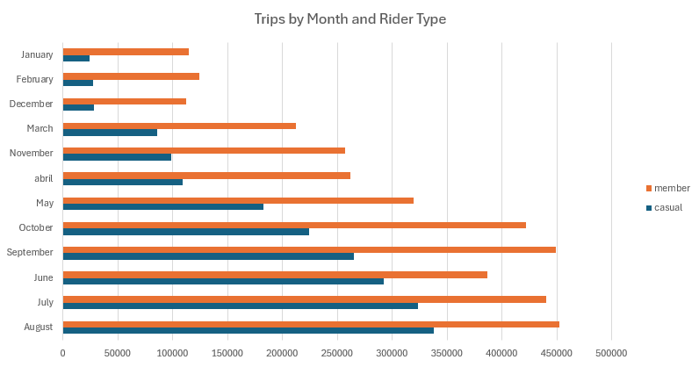
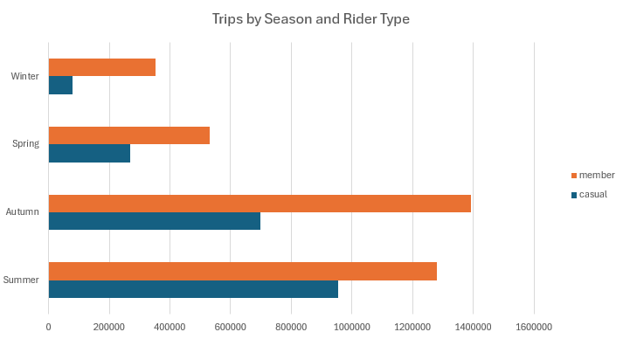
Trips by Month and Season of the year
Both user groups show a clear seasonal pattern, with bike usage peaking during summer and remaining high in autumn, while decreasing in colder months, highlighting seasonal demand trends.
Recommendations
Focus marketing and membership campaigns during summer and autumn, and introduce promotions in low-demand months to encourage bike usage year-round.

Slide 9
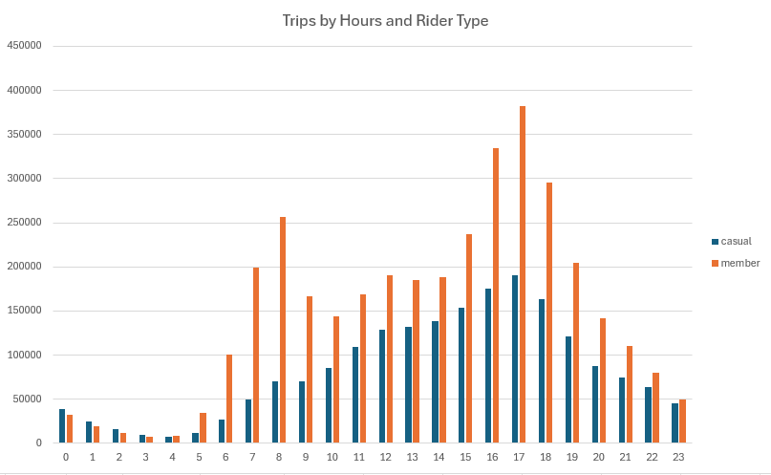
Trips by Hours
Bike usage peaks between 7:00–9:00 AM and 3:00–7:00 PM, suggesting that many users rely on the service for daily commuting and creating opportunities to optimize operations and targeted marketing.
Recommendations
Launch membership campaigns targeting users during peak commuting hours.
Ensure sufficient bike availability during peak demand periods.
Analyze the relationship between bike availability and trip volume to optimize fleet distribution.

Slide 10
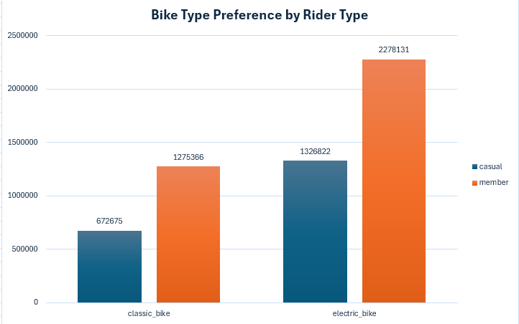
Trips by Bike Type
Both casual riders and annual members show a clear preference for electric bikes, highlighting their importance to the user experience and the need to assess whether the current fleet meets demand.
Recommendations
Evaluate whether the current electric bike fleet is sufficient to meet demand.
Promote classic bikes if expanding the electric fleet is not feasible.
Assess the operational impact of any fleet expansion or redistribution.

Slide 11
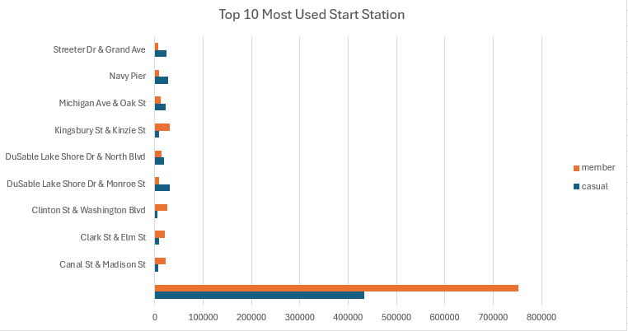
Top 10 Most Used Station
Canal St & Madison St is the most frequently used station for both casual riders and annual members, making it a key location that requires further analysis to understand the factors driving its high demand.
Recommendations
Analyze the station's demand drivers to optimize bike allocation, station capacity, and overall operational efficiency.

Slide 12
Executive Summary
This analysis was conducted to understand the behavioral differences between annual members and casual riders of the Cyclistic service. The results show significant differences in usage patterns, including seasonality, peak activity times, average trip duration, and trip volume for each group. These findings provide valuable information for designing marketing strategies aimed at increasing the conversion of casual riders to annual members, thereby contributing to the company's growth and profitability.

Slide 13
Business Insights
The analysis revealed that annual members primarily use bicycles for their daily commutes. This conclusion is supported by hourly usage patterns, which show peak demand during typical commuting times.
On the other hand, casual riders primarily use the service for recreational purposes. The graphs show a significant increase in usage during weekends and the summer season, suggesting a connection to leisure activities and vacations.
These behavioral differences present an opportunity to develop targeted marketing campaigns, offering promotions and benefits aimed at casual users to encourage them to become annual members.

Slide 14
Storytelling
Cyclistic has two customer segments: annual members and casual riders. At first glance, both groups use the same bike-sharing service; however, the data analysis reveals that their riding behaviors are significantly different.
The results highlight key differences in ride duration, seasonality, preferred days of the week, and peak riding hours. These patterns indicate that each customer segment uses the service for different purposes, providing valuable insights into their mobility habits and needs.
These behavioral differences represent an opportunity to develop more targeted and personalized marketing strategies aimed at converting casual riders into annual members. However, to evaluate the effectiveness of these strategies, it will be essential to continuously monitor their performance and measure their impact over time.
The analysis provided a solid, data-driven foundation for identifying the key behavioral differences between both customer segments. These insights will support future business decisions and help Cyclistic implement strategies focused on increasing annual memberships and driving long-term business growth.

Slide 15
Key Findings
Casual riders and annual members show different travel behaviors and usage patterns.
Casual riders tend to take longer and more recreational trips, especially on weekends.
Bike usage is influenced by seasonality, with peak demand during summer and autumn.
Demand is concentrated during commuting hours, highlighting operational and marketing opportunities.
Electric bikes are the preferred choice for both user groups.
Canal St & Madison St is the busiest station, indicating a strategic location within the network.

Slide 16
Strategic Recommendations
Develop targeted membership campaigns for casual riders based on their travel patterns.
Focus marketing efforts during weekends and high-demand seasons.
Optimize bike availability during peak commuting hours.
Evaluate the capacity of the electric bike fleet and promote classic bikes when appropriate.
Analyze high-demand stations to improve bike allocation and operational efficiency.

Slide 17
Next Steps
Analyze bike availability during peak demand periods.
Investigate the factors driving demand at the busiest stations.
Measure the impact of marketing campaigns on membership conversion.
Evaluate the relationship between fleet availability and trip demand.

Slide 18
"Data tells a story. The value comes from turning that story into better business decisions."

